Slide 1
Course
AWS Cloud Practitioner
MaxCloud

Slide 2
10
Class
Tools for DevOps

Slide 3
AWS CodeCommit
AWS CodeCommit is a secure, highly scalable, fully managed source control service that hosts private Git repositories.

Slide 4
AWS CodeBuild
AWS CodeBuild is a fully managed continuous integration service that compiles source code, runs tests, and produces ready-to-deploy software packages.

Slide 5
AWS CodeDeploy
AWS CodeDeploy is a fully managed deployment service that automates software deployments to various compute services, such as Amazon Elastic Compute Cloud (EC2), Amazon Elastic Container Service (ECS), AWS Lambda, and your on-premises servers.

Slide 6
AWS CodePipeline
AWS CodePipeline is a fully managed continuous delivery service that helps you automate your release pipelines for fast and reliable application and infrastructure updates.

Slide 7
AWS CodeStar
AWS CodeStar enables you to quickly develop, build, and deploy applications on AWS. AWS CodeStar provides a unified user interface, enabling you to easily manage your software development activities in one place. With AWS CodeStar, you can set up your entire continuous delivery toolchain in minutes, allowing you to start releasing code faster.

Slide 8
AWS CodeArtifact
CodeArtifact allows you to store artifacts using popular package managers and build tools like Maven, Gradle, npm, Yarn, Twine, pip, NuGet, and SwiftPM. CodeArtifact can automatically fetch software packages on demand from public package repositories so you can access the latest versions of application dependencies.

Slide 9
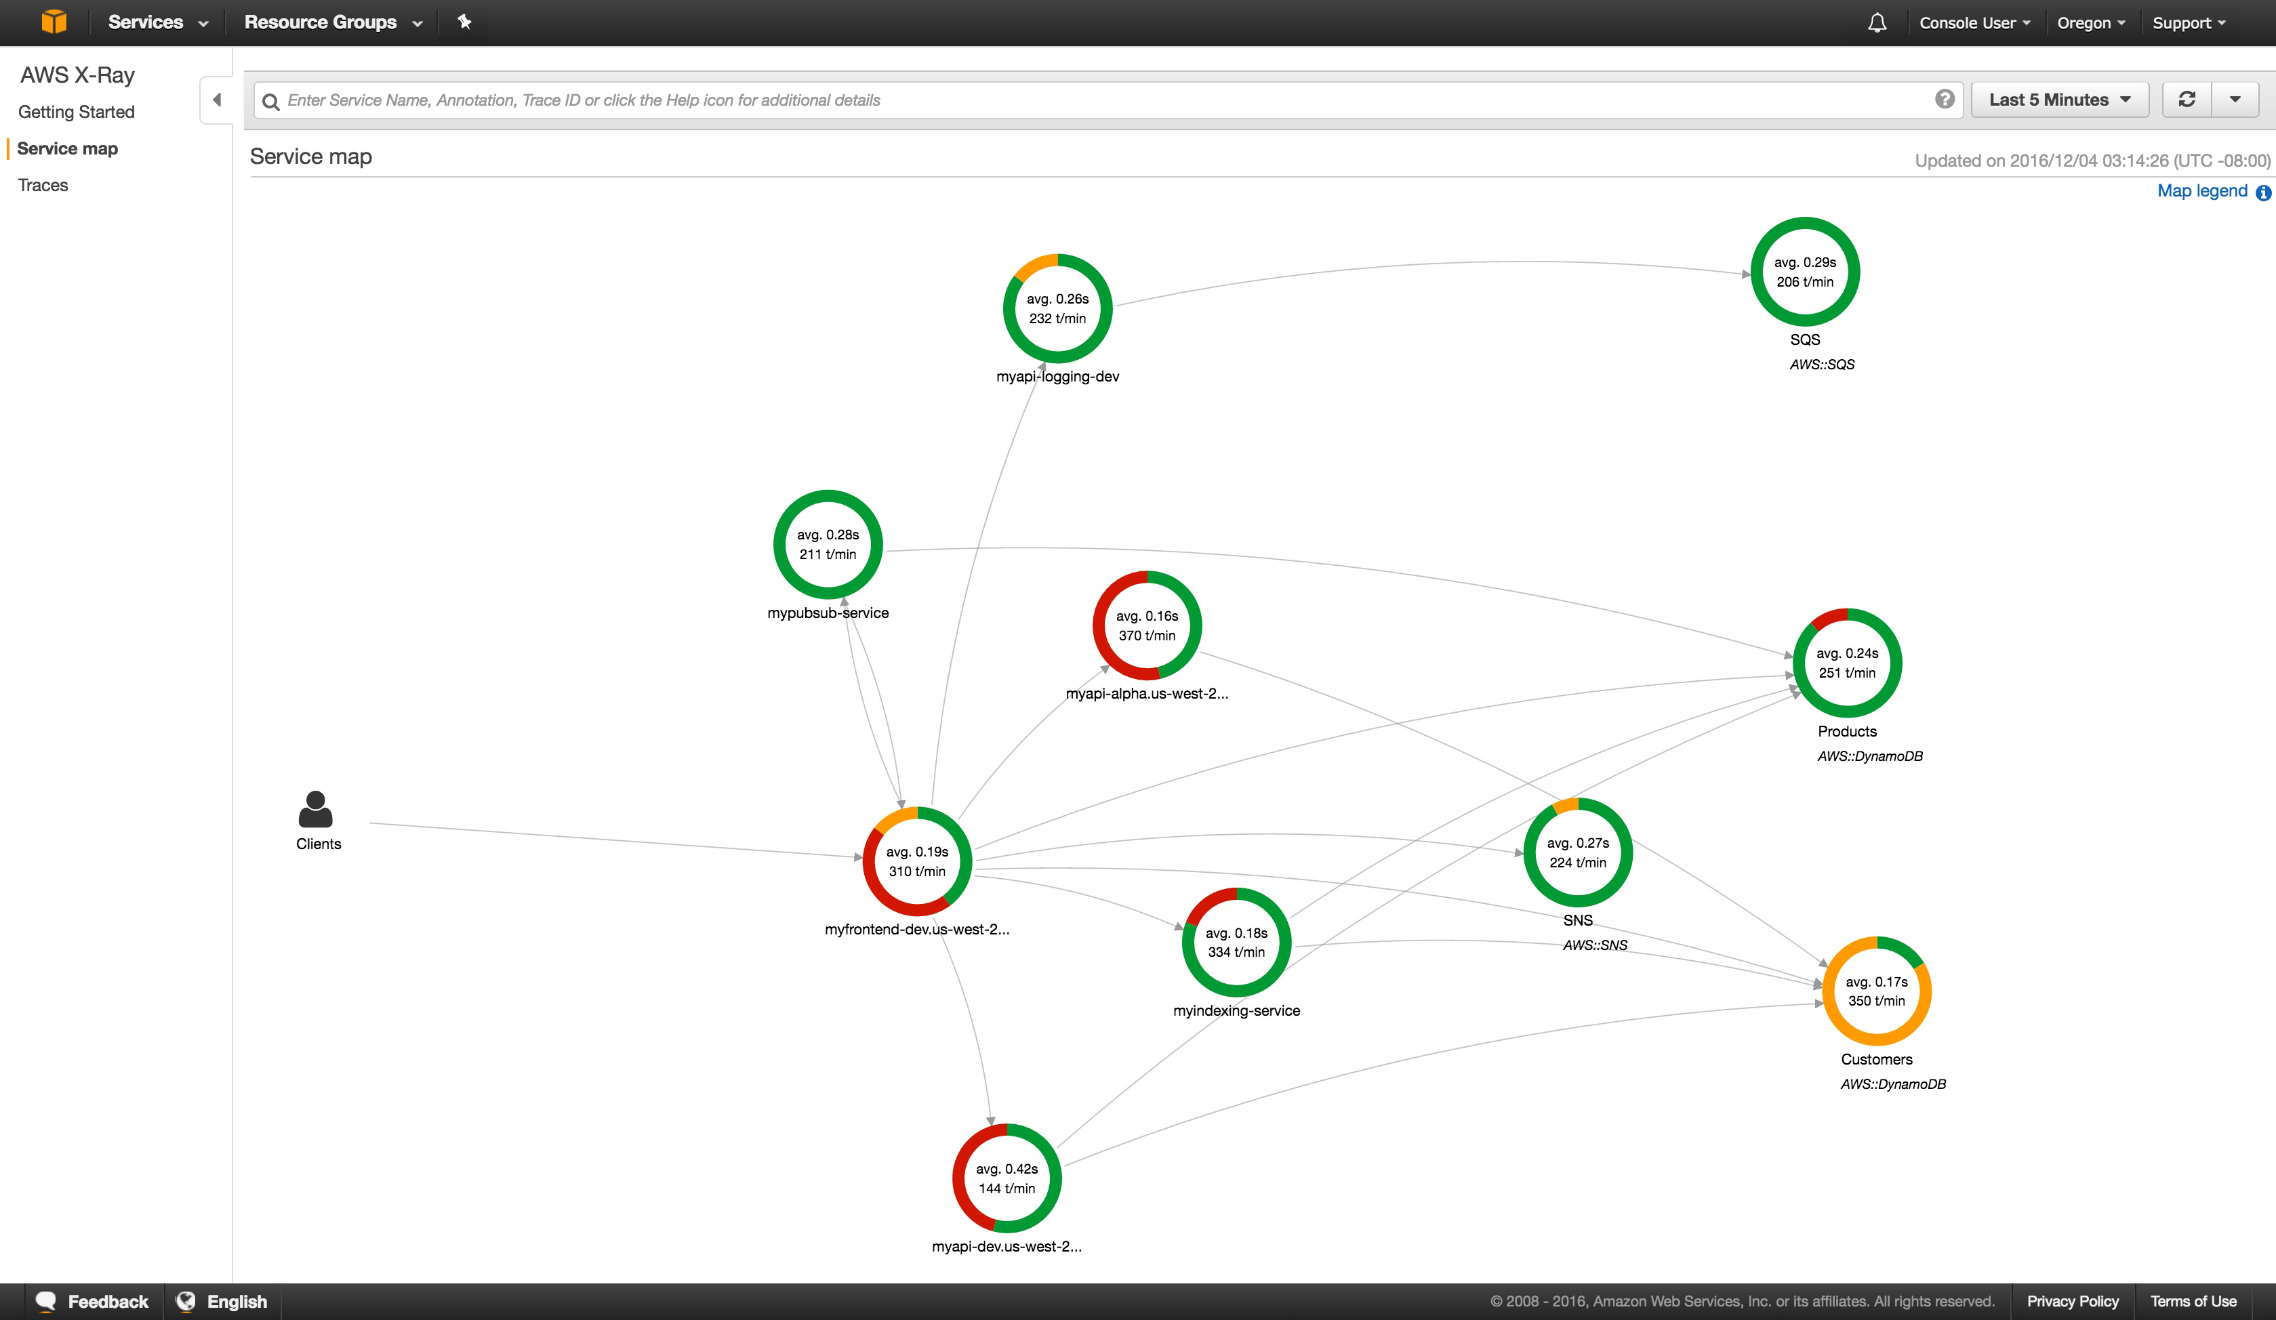
AWS X-Ray
AWS X-Ray provides a complete view of requests as they travel through your application and filters visual data across payloads, functions, traces, services, APIs, and more with no-code and low-code motions.

Slide 10
Muchas Gracias

